Slide 1
Data@ANZ
Exploratory Data Analysis
Akash Kumar Jha
8093akash@gmail.com

Slide 2
Quick glance at the data:
The Given Dataset contains 12043 transactions from 100 unique customers / account.
We have 23 features for the analysis those are : 'status', 'card_present_flag', 'bpay_biller_code', 'account', 'currency', 'long_lat', 'txn_description', 'merchant_id', 'merchant_code', 'first_name', 'balance', 'date', 'gender', 'age','merchant_suburb', 'merchant_state', 'extraction', 'amount','transaction_id', 'country', 'customer_id', 'merchant_long_lat', 'movement’.
Among these some of the columns are irrelevant for the analysis.
Dataset contains 3 months worth of transaction, transaction period 01/08/2018 to 31/10/2018. Total 92 days.

Slide 3
Exploratory data analysis insights.
The Average number of customer transaction per day is - 133.
The Average amount of transaction per day is - 190.61 AUD. Although the mean transaction range from 100-400 AUD.
Male customers spends higher amount on transactions.

Slide 4
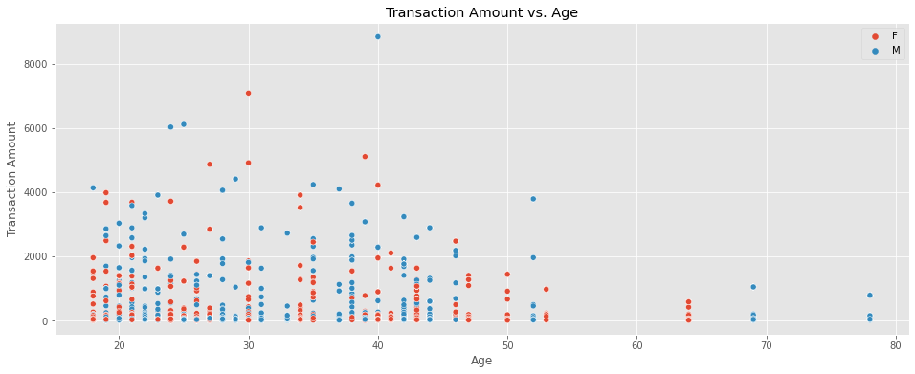
Exploratory data analysis insights.
Majority of the customers belong to the age group ranging from 18 - 55.

Slide 5
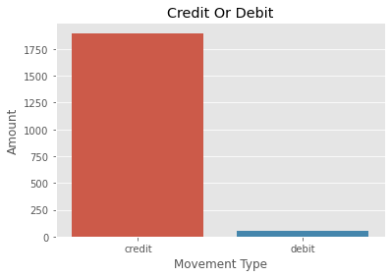
Exploratory data analysis insights.
Most of the customers
made credit transactions
over debit transactions.
After segregating the data by month we observe that the amount of average transactions for the month of August, September and October are - 185, 182 & 196 AUD

Slide 6
Thank you!! Any questions?

